Slide 1

Chapter 7: Project Cost Management
Information Technology Project Management, Seventh Edition
Note: See the text itself for full citations.

Slide 2
Learning Objectives
Understand the importance of project cost management
Explain basic project cost management principles, concepts, and terms
Describe the process of planning cost management
Discuss different types of cost estimates and methods for preparing them

Slide 3
Learning Objectives
Understand the processes of determining a budget and preparing a cost estimate for an information technology (IT) project
Understand the benefits of earned value management and project portfolio management to assist in cost control
Describe how project management software can assist in project cost management

Slide 4
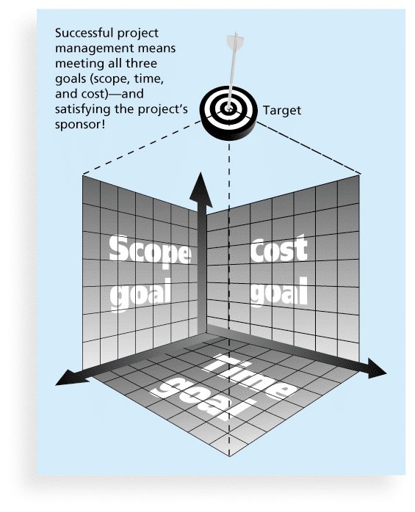
What Is a Project?
A project is “a temporary endeavor undertaken to create a unique product, service, or result” (PMBOK® Guide, 5th Edition, 2012)
Project management is “the application of knowledge, skills, tools and techniques to project activities to meet project requirements” (PMBOK® Guide, 5th Edition, 2012)
Triple Constraint of Project Management

Slide 5
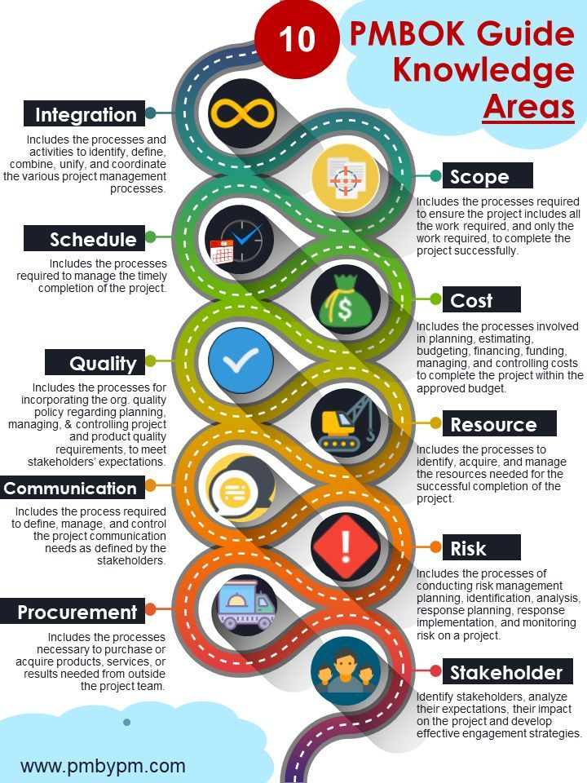

Slide 6
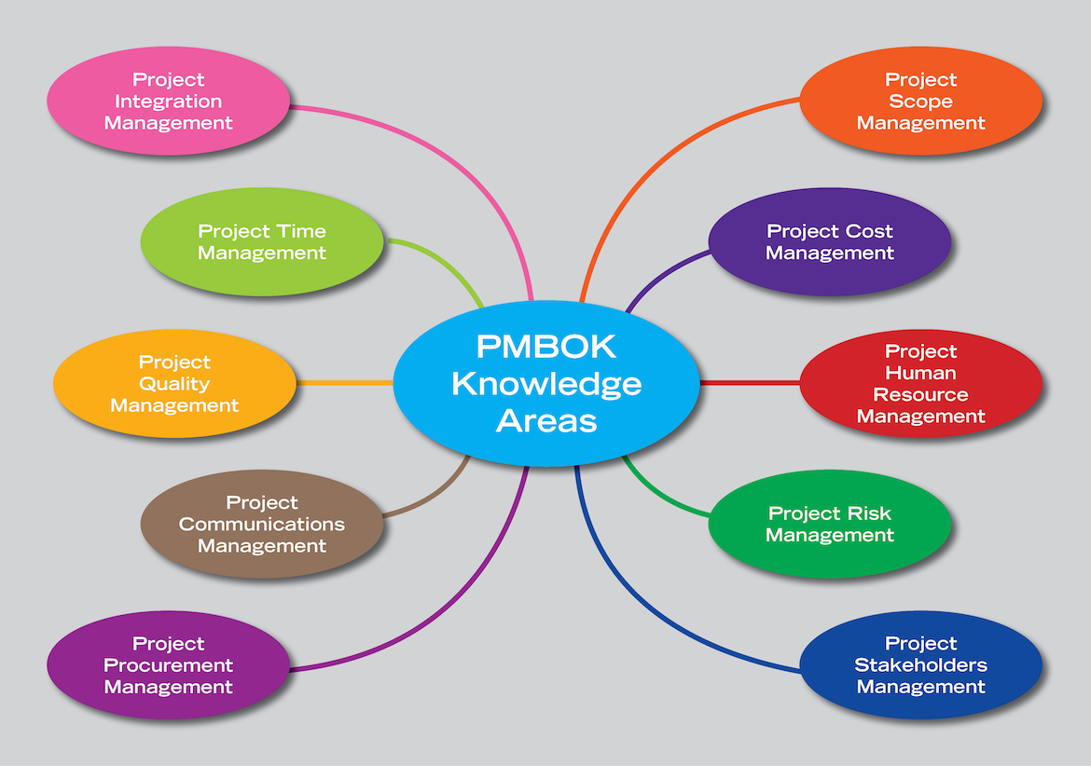

Slide 7
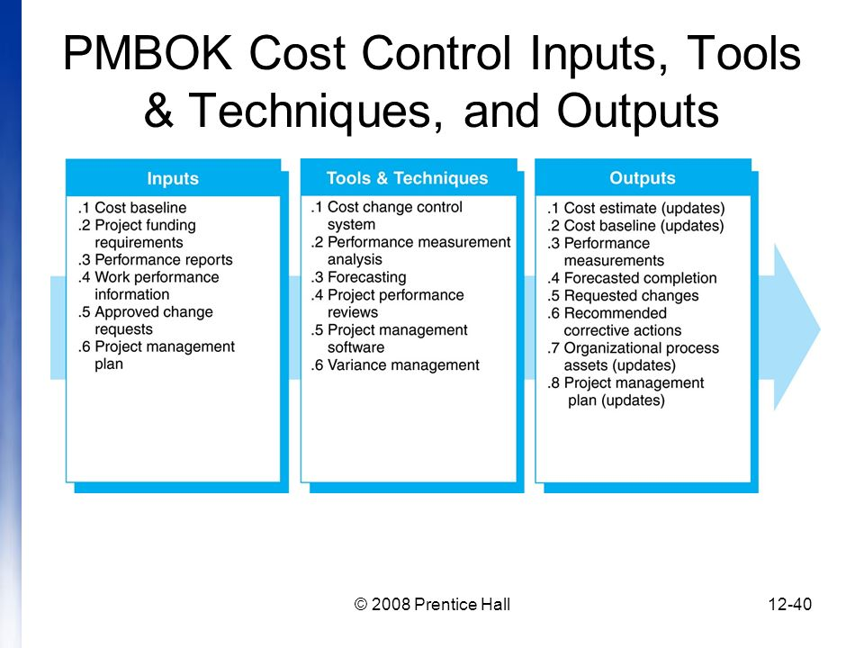

Slide 8
The Importance of Project Cost Management
IT projects have a poor track record for meeting budget goals
The CHAOS studies found the average cost overrun (the additional percentage or dollar amount by which actual costs exceed estimates) ranged from 180 percent in 1994 to 43 percent in 2010
A 2011 Harvard Business Review study reported an average cost overrun of 27 percent. The most important finding was the discovery of a large number of gigantic overages or “black swans”

Slide 9
What Went Wrong?
The U.S. government, especially the IRS, continues to provide examples of how not to manage costs
A series of project failures by the IRS in the 1990s cost taxpayers more than $50 billion a year
In 2006, the IRS was in the news for a botched upgrade to its fraud-detection software, costing $318 million in fraudulent refunds that didn’t get caught
A 2008 Government Accountability Office (GAO) report stated that more than 400 U.S. government agency IT projects, worth an estimated $25 billion, suffer from poor planning and underperformance
The United Kingdom’s National Health Service IT modernization program was called the greatest IT disaster in history with an estimated $26 billion overrun. It was finally scrapped in 2011.

Slide 10
What is Cost and Project Cost Management?
Cost is a resource sacrificed or foregone to achieve a specific objective or something given up in exchange
Costs are usually measured in monetary units like dollars
Project cost management includes the processes required to ensure that the project is completed within an approved budget

Slide 11
Project Cost Management Processes
Planning cost management: determining the policies, procedures, and documentation that will be used for planning, executing, and controlling project cost.
Estimating costs: developing an approximation or estimate of the costs of the resources needed to complete a project
Determining the budget: allocating the overall cost estimate to individual work items to establish a baseline for measuring performance
Controlling costs: controlling changes to the project budget

Slide 12
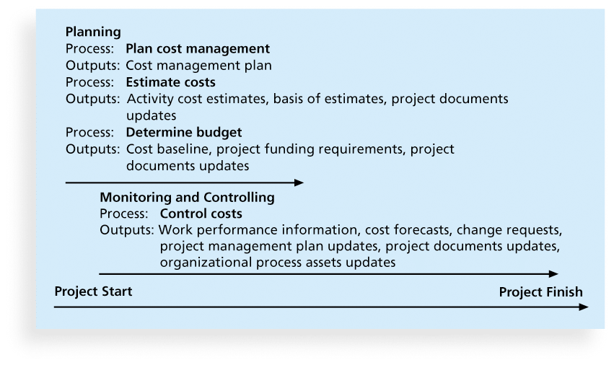
Figure 7-1. Project Cost Management Summary

Slide 13
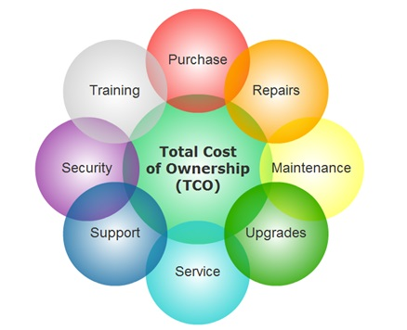
Basic Principles of Cost Management
Most members of an executive board better understand and are more interested in financial terms than IT terms , so IT project managers must speak their language
Profits are revenues minus expenditures
Profit margin is the ratio of revenues to profits
Life cycle costing considers the total cost of ownership, or development plus support costs, for a project
Cash flow analysis determines the estimated annual costs and benefits for a project and the resulting annual cash flow

Slide 14
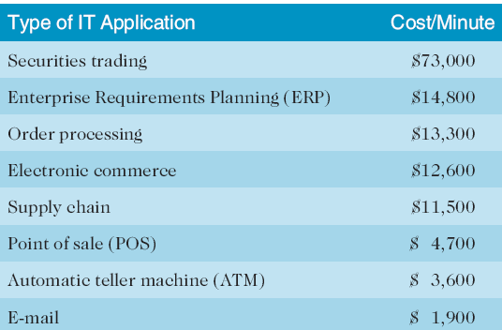
Table 7-1. Cost of Downtime for IT Applications
Source: The Standish Group International, “Trends in IT Value,” www.standishgroup.com (2008).

Slide 15
What Went Right?
Many organizations use IT to reduce operational costs
Technology has decreased the costs associated with processing an ATM transaction:
In 1968, the average cost was $5.
In 1978, the cost went down to $1.50
In 1988, the cost was just a nickel.
In 1998, it only cost a penny.
In 2008, the cost was just half a penny!
Investing in green IT and other initiatives has helped both the environment and companies’ bottom lines. Michael Dell, CEO of Dell, reached his goal to make his company “carbon neutral” in 2008. As of March 2012, Dell had helped its customers save almost $7 billion in energy costs

Slide 16
Types of Costs and Benefits
Tangible costs or benefits are those costs or benefits that an organization can easily measure in dollars
Intangible costs or benefits are costs or benefits that are difficult to measure in monetary terms
Direct costs are costs that can be directly related to producing the products and services of the project
Indirect costs are costs that are not directly related to the products or services of the project, but are indirectly related to performing the project
Sunk cost is money that has been spent in the past; when deciding what projects to invest in or continue, you should not include sunk costs

Slide 17
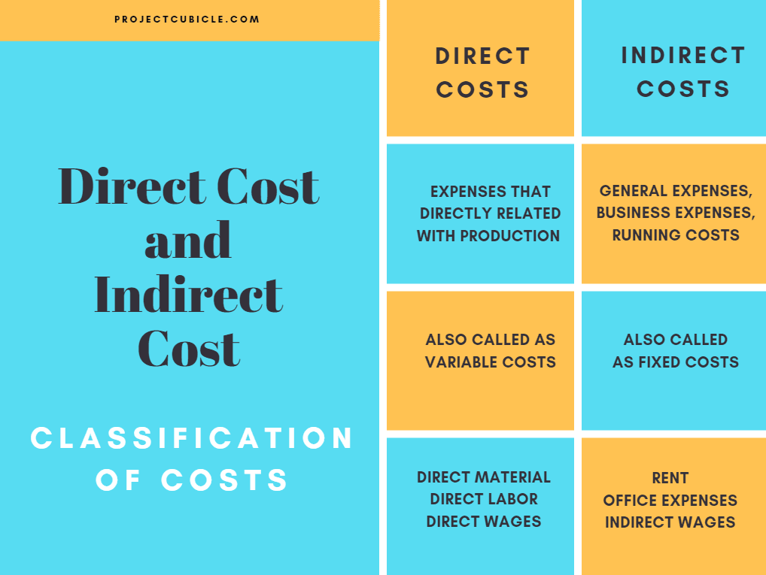

Slide 18
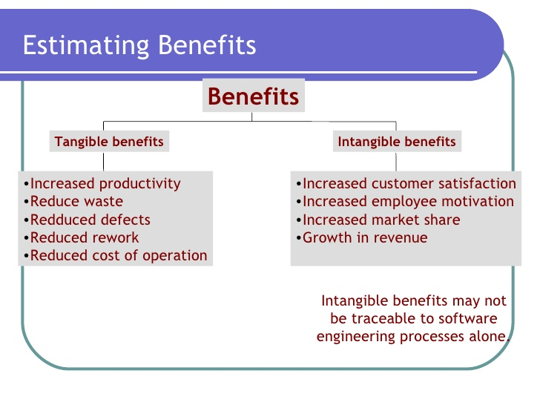

Slide 19
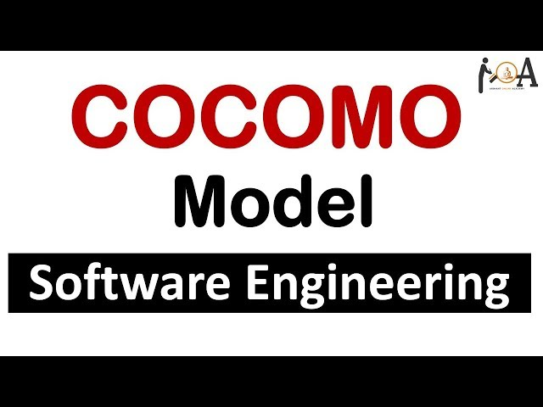

Slide 20
More Basic Principles of Cost Management
Learning curve theory states that when many items are produced repetitively, the unit cost of those items decreases in a regular pattern as more units are produced
Reserves are dollars included in a cost estimate to mitigate cost risk by allowing for future situations that are difficult to predict
Contingency reserves allow for future situations that may be partially planned for (sometimes called known unknowns) and are included in the project cost baseline
Management reserves allow for future situations that are unpredictable (sometimes called unknown unknowns
Contingency Reserve is the budgeted dollars or scheduled time that are set aside for risks that have been identified and accepted or identified and have mitigating responses developed. It will cover the costs and necessary time to handle any accepted risks should they occur and the costs or time of mitigating any risks as needed. Contingency reserves in the budget may be a percentage of the overall budget, a fixed amount, or an amount determined based on quantitative analysis.

Slide 21
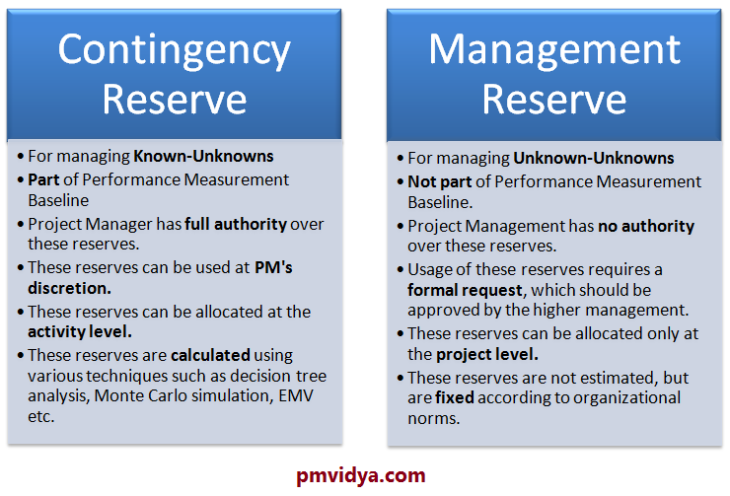

Slide 22
Planning Cost Management
The project team uses expert judgment, analytical techniques, and meetings to develop the cost management plan
A cost management plan includes:
Level of accuracy and units of measure
Organizational procedure links
Control thresholds
Rules of performance measurement
Reporting formats
Process descriptions

Slide 23
Estimating Costs
Project managers must take cost estimates seriously if they want to complete projects within budget constraints
It’s important to know the types of cost estimates, how to prepare cost estimates, and typical problems associated with IT cost estimates

Slide 24
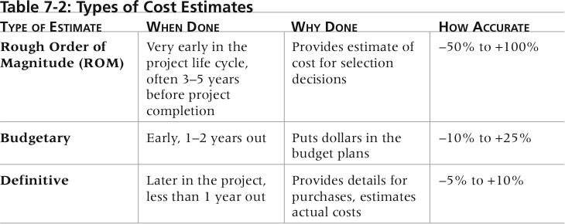
Table 7-2. Types of Cost Estimates

Slide 25
More on Cost Estimates
The number and type of cost estimates vary by application area. The Association for the Advancement of Cost Engineering International identifies five types of cost estimates for construction projects: order of magnitude, conceptual, preliminary, definitive, and control
Estimates are usually done at various stages of a project and should become more accurate as time progresses
A large percentage of total project costs are often labor costs

Slide 26
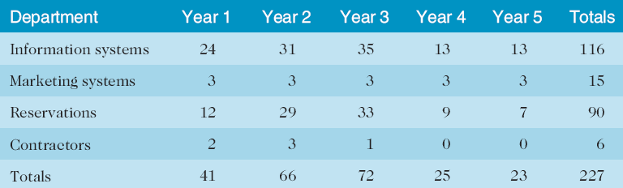
Table 7-3. Maximum FTE by Department by Year

Slide 27
Cost Estimation Tools and Techniques
Basic tools and techniques for cost estimates:
Analogous or top-down estimates: use the actual cost of a previous, similar project as the basis for estimating the cost of the current project
Bottom-up estimates: involve estimating individual work items or activities and summing them to get a project total
Parametric modeling uses project characteristics (parameters) in a mathematical model to estimate project costs

Slide 28
Typical Problems with IT Cost Estimates
Estimates are done too quickly
People lack estimating experience
Human beings are biased toward underestimation
Management desires accuracy

Slide 29
Sample Cost Estimate
See pages 284-289 for a detailed example of creating a cost estimate for the Surveyor Pro project described in the opening case
Before creating an estimate, know what it will be used for, gather as much information as possible, and clarify the ground rules and assumptions for the estimate
If possible, estimate costs by major WBS categories
Create a cost model to make it easy to make changes to and document the estimate

Slide 30
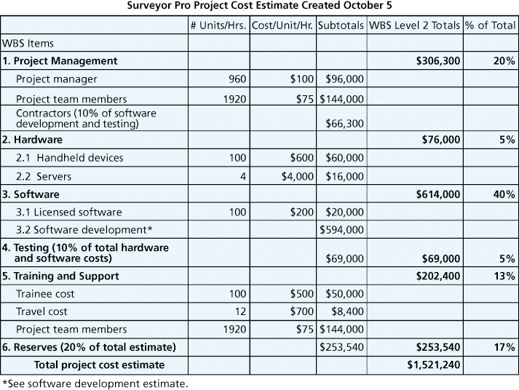
Figure 7-2. Surveyor Pro Project Cost Estimate

Slide 31
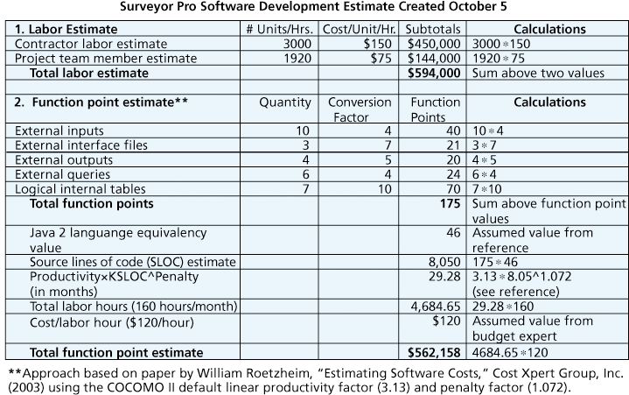
Figure 7-3. Surveyor Pro Software Development Estimate

Slide 32
Determining the Budget
Cost budgeting involves allocating the project cost estimate to individual work items over time
The WBS is a required input to the cost budgeting process since it defines the work items
Important goal is to produce a cost baseline
a time-phased budget that project managers use to measure and monitor cost performance

Slide 33
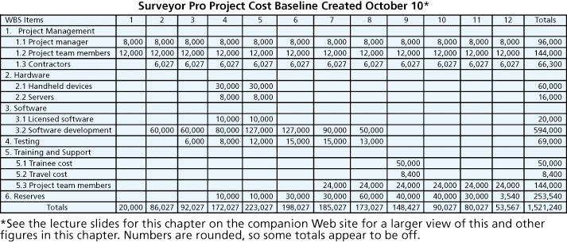
Figure 7-4. Surveyor Pro Project Cost Baseline

Slide 34
Media Snapshot
U.S. President Barack Obama successfully used the media and information technology in his campaign
The Obama campaign used 16 different online social platforms to interact with people of various backgrounds; sources say 80 percent of all contributions originated from these social networks
In a 60 Minutes episode shortly after the election, campaign leaders discussed some of the details of the campaign
The Web site My.BarackObama was created to develop an online community with over a million members

Slide 35
Controlling Costs
Project cost control includes
Monitoring cost performance
Ensuring that only appropriate project changes are included in a revised cost baseline
Informing project stakeholders of authorized changes to the project that will affect costs
Many organizations around the globe have problems with cost control

Slide 36
Earned Value Management (EVM)
EVM is a project performance measurement technique that integrates scope, time, and cost data
Given a baseline (original plan plus approved changes), you can determine how well the project is meeting its goals
You must enter actual information periodically to use EVM
More and more organizations around the world are using EVM to help control project costs

Slide 37
Earned Value Management Terms
The planned value (PV), formerly called the budgeted cost of work scheduled (BCWS), also called the budget, is that portion of the approved total cost estimate planned to be spent on an activity during a given period
Actual cost (AC), formerly called actual cost of work performed (ACWP), is the total of direct and indirect costs incurred in accomplishing work on an activity during a given period
The earned value (EV), formerly called the budgeted cost of work performed (BCWP), is an estimate of the value of the physical work actually completed
EV is based on the original planned costs for the project or activity and the rate at which the team is completing work on the project or activity to date

Slide 38
Rate of Performance
Rate of performance (RP) is the ratio of actual work completed to the percentage of work planned to have been completed at any given time during the life of the project or activity
Brenda Taylor, Senior Project Manager in South Africa, suggests this term and approach for estimating earned value
For example, suppose the server installation was halfway completed by the end of week 1. The rate of performance would be 50% because by the end of week 1, the planned schedule reflects that the task should be 100 percent complete and only 50 percent of that work has been completed

Slide 39
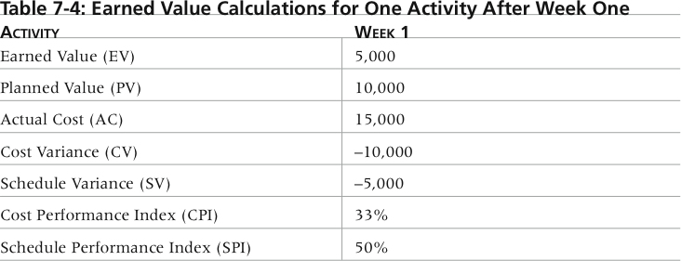
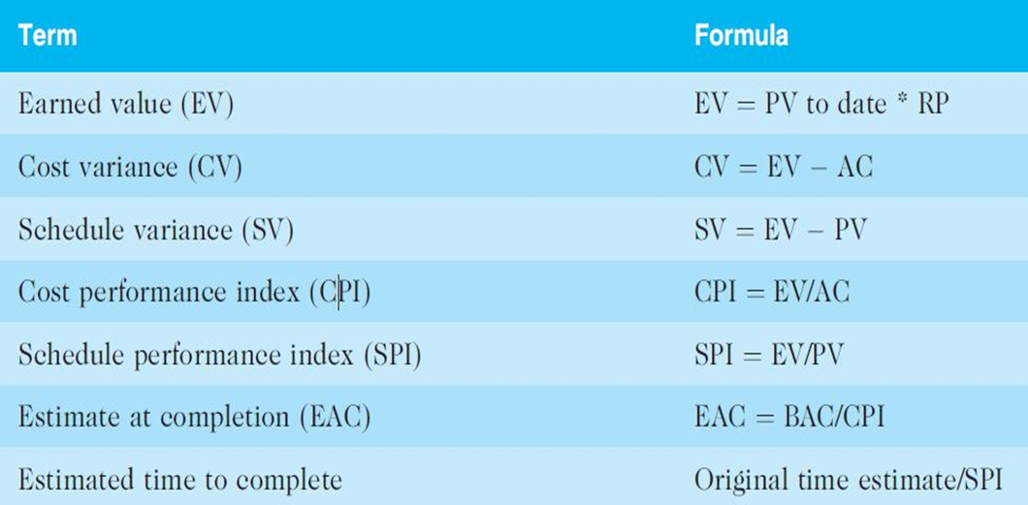
Table 7-4. Earned Value Calculations for One Activity After Week One

Slide 40
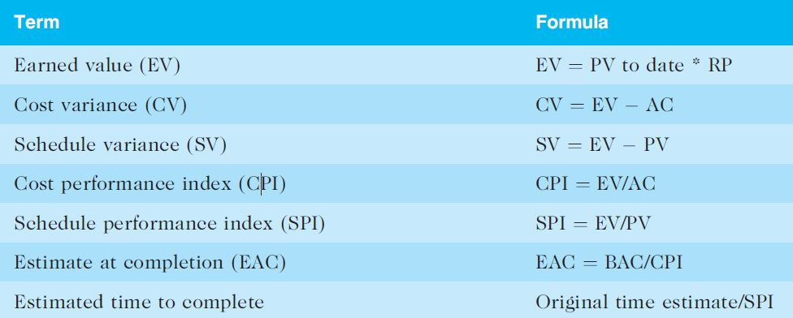
Table 7-5. Earned Value Formulas

Slide 41
Rules of Thumb for Earned Value Numbers
Negative numbers for cost and schedule variance indicate problems in those areas
CPI and SPI less than 100% indicate problems
Problems mean the project is costing more than planned (over budget) or taking longer than planned (behind schedule)
The CPI can be used to calculate the estimate at completion (EAC)—an estimate of what it will cost to complete the project based on performance to date. The budget at completion (BAC) is the original total budget for the project

Slide 42
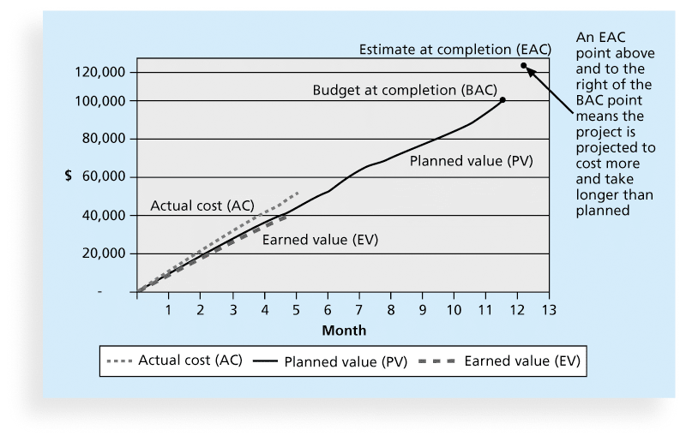
Figure 7-5. Earned Value Chart for Project after Five Months

Slide 43
Using Software to Assist in Cost Management
Spreadsheets are a common tool for resource planning, cost estimating, cost budgeting, and cost control
Many companies use more sophisticated and centralized financial applications software for cost information
Project management software has many cost-related features, especially enterprise PM software
Portfolio management software can help reduce costs

Slide 44
Chapter Summary
Project cost management is a traditionally weak area of IT projects, and project managers must work to improve their ability to deliver projects within approved budgets
Main processes include
Plan cost management
Estimate costs
Determine the budget
Control costs

